Slide 1
The Ministry of Helps
Week 1 (22 Aug): supernatural helps ministry throughout the bible
Week 2 (29 aug): qualifications for a high call
Week 3 (5 sep): the problem of burn-out and how to avoid it
Week 4 (12 sep): finding and staying in your place of ministry
Week 5 (19 sep): getting along with difficult people
26 September: Q & A

Slide 2
Course Objectives
To understand the supernatural gift of Helps
To learn the diversity of gifts involved in the Helps ministry
To study the spiritual attributes of a servant of God
To study the impartation that comes to a Helps minister
To help each believer find their own unique place of service
To learn how to avoid burn-out in the Helps ministry

Slide 3
Module 5: Session 5 Getting Along With Difficult People

Slide 4
Getting Along with Difficult People
This can be one of the main difficulties to overcome when staying in your place of ministry
Some define a difficult person as "someone who is not exactly like me"
There are four basic temperament types which blend together to form your unique personality
Temperament is God-created
Every temperament has its unique strengths and weaknesses
A study of temperaments will help you understand why you - and others - often feel, think, and act the way you do

Slide 5
The DISC Model of Human Behavior “D” Behavior - CHOLERIC
Dominating, Directing, Driving, Demanding, Deter­mined, Decisive, Doing
Active and Task-oriented

Slide 6
A Summary of “D’s” Strengths
Strong-willed and self-disciplined, confident, determined to succeed
Practical, organized
Leader, good judge of people, can make quick and bold decisions
Optimistic, visionary, likes a challenge, not easily discouraged

Slide 7
A Summary of “D’s” Weaknesses
Hot-tempered, revengeful, hostile
Cruel, unsympathetic, believes that "the end justifies the means"
Impetuous, starts project they later regret
Self-sufficient, proud, haughty, domineering
Hard for them to apologize

Slide 8
Basic Motivation for a “D”
Loves a Challenge
and Enjoys Being in Control

Slide 9
“D’s” need a Partner or Teammates who will:
Balance them by recognizing the needs and feelings of others
Research the facts and weigh the pros and cons
Use caution and calculate the risk
Structure a predictable environment
Stand up and challenge them

Slide 10
To be Most Effective, “D’s” need to learn:
That they need people
That relaxation is not a crime – pace yourself and relax more
That everybody has a boss
To balance intuitive decisions with reasons and practical experience

Slide 11
Biblical Example of a “D”
Determined Apostle Paul:
He had a plan to stop the Church. God had to knock him to the ground. Later, as a missionary, he would not quit, no matter what. He Focused on the goal.

Slide 12
The DISC Model of Human Behavior “I” Behavior - SANGUINE
Inspiring, Influencing, Impressing, Interactive, Interested in people, Impulsive
Active and People-oriented

Slide 13
A Summary of “I’s” Strengths
Enjoys life, is always cheerful and enthusiastic Optimistic, lives in the present, doesn’t worry about the past or the future
Friendly, genuinely loves people
Compassionate and responsive to the feelings of those around them, quick to apologize
Expressive, dynamic

Slide 14
A Summary of “I’s” Weaknesses
Restless, impractical, disorganized, doesn't plan ahead, non-productive
Weak-willed, undisciplined, willing to compromise, prone to problems with lust and overspending
Egotistical, dominate the conversation, talk about themselves
Impulsively act or talk before they think things through
Emotionally driven, given to outbursts of anger or sudden tears

Slide 15
Basic Motivation for an “I”
Wants Recognition and Acceptance

Slide 16
“I’s” need a Partner or Teammates who will:
Concentrate on the task
Set priorities and deadlines (control the time)
Seek the facts and take a logical approach

Slide 17
To be Most Effective, “I’s” need to learn:
To stay on the task
That listening better will improve one's popularity
To make objective decisions
To be more realistic in appraising others

Slide 18
Biblical Example of an “I”
Impulsive Apostle Peter:
He was the first to walk on water; to identify Jesus as the Christ; to promise, “I will never deny You.” Gave a dynamic speech on the Day of Pentecost.

Slide 19
The DISC Model of Human Behavior “S” Behavior - PHLEGMATIC
Steady, Stable, Shy, Security-oriented, Servant, Submissive, Specialist
Passive and People-oriented

Slide 20
A Summary of “S’s” Strengths
Calm and quiet
Easy-going and patient, enjoys people, a good listener, the most likeable of all the temperaments
Dependable, a faithful friend
Objective thinker
Diplomatic, a natural peacemaker, a good negotiator
Humorous
Efficient, organized and practical

Slide 21
A Summary of “S’s” Weaknesses
Unmotivated, slow, and lazy
A procrastinator
Selfish with their time, does not want to get involved
Stingy, frugal with money, a hoarder by nature
Stubborn, does not like change
Self-protective, builds a wall around themselves
Indecisive and fearful

Slide 22
Basic Motivation for an “S”
Wants Stability and Support

Slide 23
“S’s” need a Partner or Teammates who will:
Balance them by being able to react quickly to unexpected change
Help them prioritize their work
Give them time to adjust to changes
Apply pressure on them to stretch themselves and to get involved
Show them how their personal effort contributes to the group effort
Match their own level of sincerity and competence

Slide 24
To be Most Effective, “S’s” need to learn:
That change provides opportunity
That discipline is good
That boldness and taking risks is sometimes necessary

Slide 25
Biblical Example of an “S”
Steady Father Abraham:
Cared about people: his greatest desire was for a son. Used diplomacy to bargain with God for Sodom and Gomorrah. Fearful and self-protective: gave Sarah to Pharaoh to protect himself.

Slide 26
The DISC Model of Human Behavior “C” Behavior - MELANCHOLY
Cautious, Competent, Calculating, Compliant, Careful, Contemplative
Passive and Task-oriented

Slide 27
A Summary of “C’s” Strengths
Gifted, creative
Analytical, clear-thinking, and detail-oriented
Self-sacrificing and hardworking, they can be workaholics
Faithful and dependable
Perfectionist
The most sensitive of all the temperaments
Develops deep friendships

Slide 28
A Summary of “C’s” Weaknesses
Moody, gloomy, and depressed
Self-centered
Pessimistic, fearful, and indecisive - easy for them to see problems
The most critical of all the temperaments
Touchy, unsociable

Slide 29
Basic Motivation for a “C”
Wants Beauty, Quality, and Correctness

Slide 30
“C’s” need a Partner or Teammates who will:
Balance them by being able to make quick decisions
Encourage teamwork and delegation
Initiate and facilitate discussions and compromise

Slide 31
To be Most Effective, “C’s” need to learn:
To develop more tolerance for conflict - confrontation is not always bad - it gets things resolved
To be less subtle and indirect when dealing with conflicts
To respect people's personal worth as much as their accomplishments
That more optimism will lead to greater success

Slide 32
Biblical Example of a “C”
Careful Moses:
Faithful and self-sacrificing. He paid great attention to details in building the Tabernacle, following directions to the letter.

Slide 33
Getting Along with Difficult People
There is no "bad" temperament or "best ' temperament.
God's plan is teamwork - the Body of Christ working together
As we grow in the Lord, our temperament becomes increasingly controlled by the Holy Spirit. We become more like Jesus, who was able to adapt His responses to best fulfill God’s plan, moment by moment. We, too, can become "all things to all men" (1 Corinthians 9:22).

Slide 34
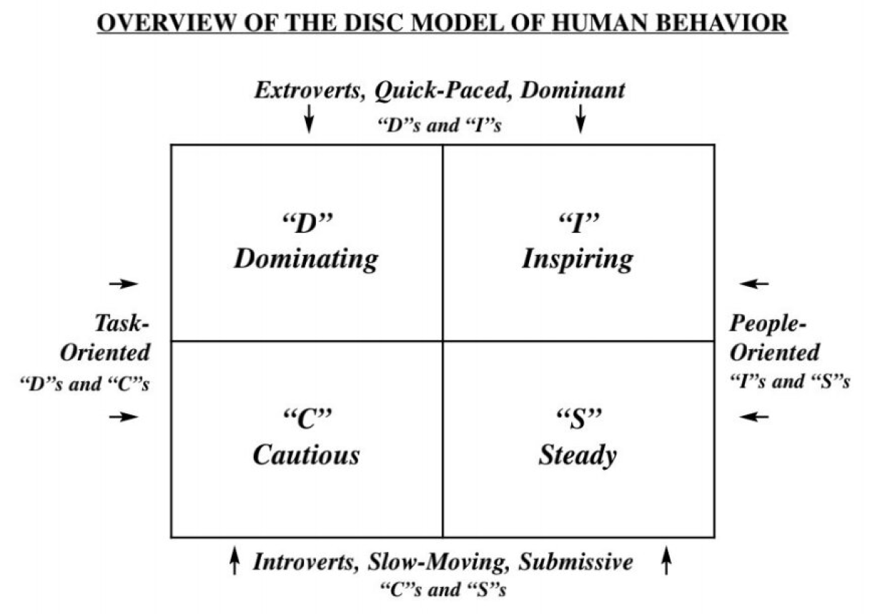

Slide 35
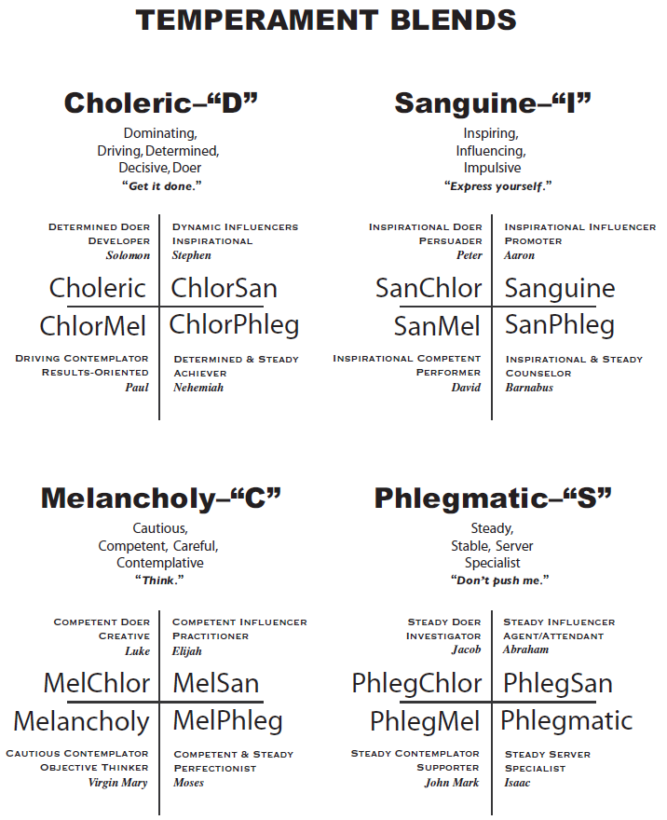

Slide 36
Learn to give our struggles over to the Lord
Trust God and commit the results to Him.
Commit your way to the Lord, Trust also in Him, and He shall bring it to pass (Psalms 37:5).
Commit your works to the Lord, and your thoughts will be established (Proverbs 16:3).
Your strength will always come by encouraging yourself in the Lord, as David did in 1 Samuel 30:6.

Slide 37
Learn to give our struggles over to the Lord
A powerful faith confession for Helps minister: "Lord, Your grace is enough. It's all I need. Your power is made perfect in my weakness.“
And he said unto me, My grace is sufficient for thee: for my strength is made perfect in weakness. Most gladly therefore will I rather glory in my infirmities [weakness], that the power of Christ may rest upon me. (2 Corinthians 12:9 AMP)

Slide 38
Faithfulness is Rewarded
When it’s time for promotion,
God knows where to find you.
For promotion cometh neither from the east nor from the west, nor from the south. But God is the judge: he putteth down one, and setteth up another (Psalms 75:6).

Slide 39
Faithfulness is Rewarded
Some are promoted within the Ministry of Helps: Joseph was promoted from slave, to overseer, to prison administrator, to prime minister.
Some receive an additional ministry position: Philip was promoted from deacon to evangelist.
God keeps good record - nothing you do is done in vain. You might be thinking no one is noticing, but God is. He may be keeping you hidden, then when the time is right and something comes up, He says,
"I know just the one for the job."

Slide 40
Faithfulness is Rewarded
Our ultimate reward is when Jesus says, “Well done!”
The faithful janitor gets the same reward as the world evangelist.
A faithful man shall abound with blessings (Proverbs 28:20a).
As you are faithful, God will bless you beyond your wildest imagination!
Your gift will open doors for you that will be a great delight!

