Slide 1
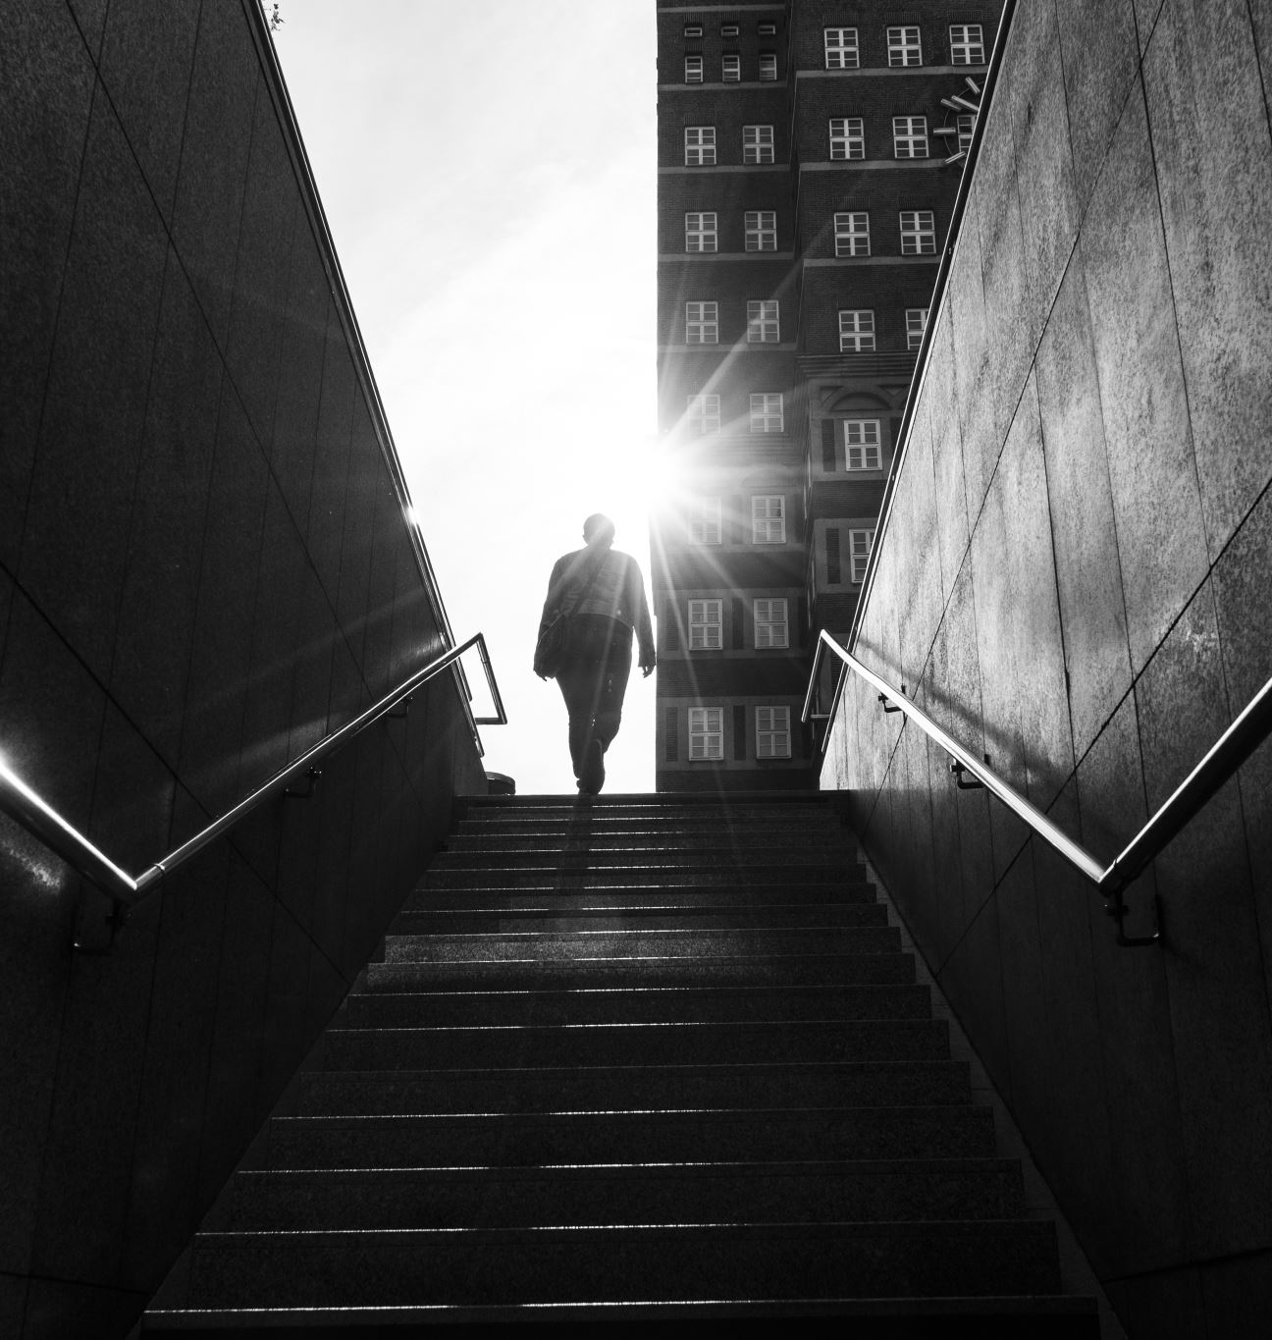
Integrity – Walking in Honesty and Honor
Week 6 | Christ-like Character Series

Slide 2
Caleb’s Story – The Same in the Dark
Caleb lived in a corrupt city but chose integrity.
He overheard a bribe and chose to speak up — not to expose, but to honor God.
He remembered: 'Integrity is being the same person when no one is watching.'

Slide 3
What Is Integrity, Really?
Being whole, undivided, and honest in public and private.
Includes boundaries, consistency, and predictability.
Proverbs 11:3 – 'The integrity of the upright will guide them.'

Slide 4
God Is Truth. Satan Is a Liar.
Truth is a Person — God. Lying aligns with Satan.
Telling the truth reflects your identity as a child of God.
'Those who deal in deception reveal who their true father is.'

Slide 5
Daily Integrity: Not Perfection, But Honesty
Integrity means owning flaws and returning to God quickly.
Caleb confessed his failures and asked for help.
'Lord, I messed up. Help me do better.'

Slide 6
Scriptural Lifestyle of Integrity
Don’t lie (Prov. 12:22), exaggerate, flatter, or steal.
Return borrowed items in better shape.
Keep promises even when it's hard (Ps. 15:4).
God never lies – Numbers 23:19

Slide 7
Keeping Priorities Straight
Caleb learned to honor God first — before ministry, work, or family.
Jesus called the disciples 'to be with Him' (Mark 3:14).
Mary chose the better part — time with Jesus (Luke 10:42).

Slide 8
Apostle Paul’s Example
Paul confronted Peter when he compromised (Gal. 2:11–12).
He lived with full awareness of God’s presence (2 Cor. 11:31).
He preached and practiced truth and honor.

Slide 9
Self-Check: Integrity Test
Do I keep my word?
Am I honest with money, time, and speech?
Do I trust God to defend me when wronged?
'When wronged, turn it over to God.' – Kenneth Copeland

Slide 10
God’s Promises for the Upright
Protection & Defense – Ps. 7:10, 41:11–12
Presence of God – Ps. 15:1–2, 140:13
Stability & Strength – Ps. 15:3–5, Prov. 10:9
Guidance & Wisdom – Prov. 11:3, 2:7, 16:17
Joy, Light, and Favor – Ps. 64:10, 97:11, Prov. 15:8

Slide 11
Caleb’s Reward
Caleb lost jobs but gained respect, peace, and lasting influence.
At retirement, his children said: 'He gave us the gift of trust.'
He walked the path of integrity — and it rewarded him.

Slide 12
Weekly Assignment
How will you walk in honesty and honor at home and work?
What’s one area you need to ask God for help in?
Which promise from God encourages you most this week?

Slide 13
Guided by Integrity
Proverbs 11:3 – The integrity of the upright will guide them.
Psalm 15:4 – He keeps an oath even when it hurts.

Slide 14
God Cannot Lie
Numbers 23:19 – God is not a man, that He should lie.
Proverbs 12:22 – The Lord detests lying lips, but He delights in people who are trustworthy.

Slide 15
God’s Presence and Protection
Psalm 7:10 – My shield is God Most High, who saves the upright in heart.
Psalm 41:11–12 – You uphold me because of my integrity.

Slide 16
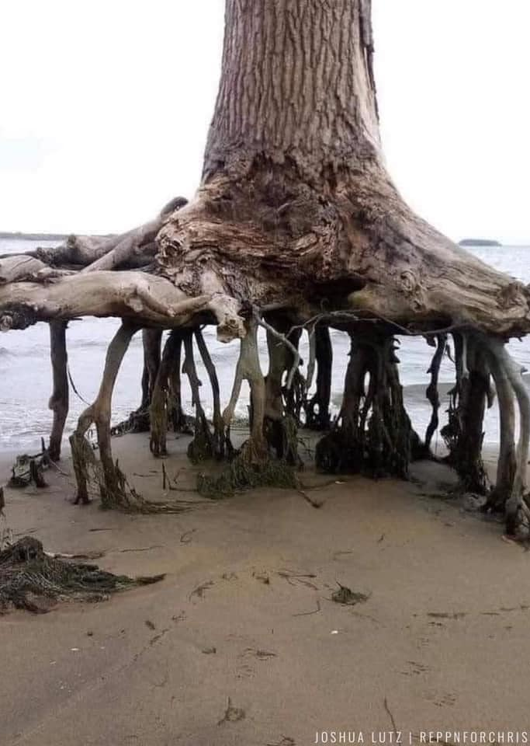

Integrity Under Pressure

