Slide 1
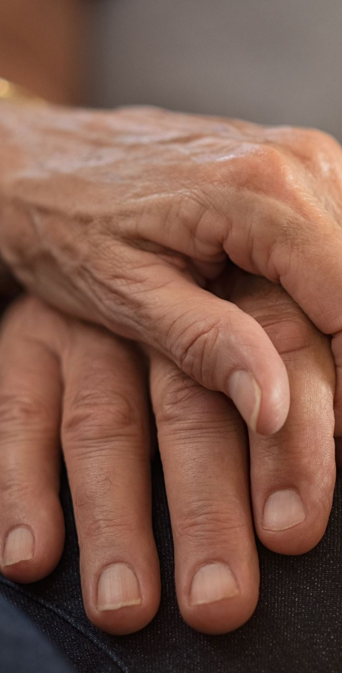
Compassion – Deep-Seated Caring
Week 11 | Christ-Like Character Series

Slide 2

'Moved to Action'
Share a time you saw a need and felt you had to do something about it.
Compassion always leads to action.

Slide 3

What Is Compassion?
Deeply moved in your inner being to the point of acting to meet a need.
Not just pity, but allowing God’s power to work through you.
Biblical compassion always produces action (Luke 7:11–15; Matt. 14:14; Mark 1:41).
Examples: Mother in 1 Kings 3, Paul's love for the church, Jesus' ministry.

Slide 4
Scriptural Instructions in Compassion
Don’t block compassion – 1 John 3:17–18.
Share resources – Luke 3:11; 1 Tim. 6:17–19.
Ministering to others = ministering to Jesus – Matt. 25:34–40.
Intercession – Ezek. 22:30; Heb. 7:25; Matt. 5:43.
Isaiah 58:6–14 – Physical help linked with spiritual ministry.

Slide 5
Group Reflection
Which instruction is easiest for you to live out?
Which is most challenging?

Slide 6
Activity – Compassion in Action
Think of one way to show compassion this week in:
1. Family
2. Community
3. Church
Share ideas briefly if you want.

Slide 7
Meditation & Challenge
Read 1 John 3:17–18 & Matthew 5:43 (MSG).
Challenge: Don’t just feel compassion—let it move you to action.

Slide 8
Promises for the Compassionate
Prosperity & refreshing – Prov. 11:25; 19:17; 28:27.
Abundant grace – 2 Cor. 9:6–8.
God’s blessings: guidance, protection, speedy healing – Isaiah 58.

Slide 9
Closing Prayer
Thank God for His compassion toward us.
1
Pray for a heart that acts quickly to meet needs.
2
Ask for opportunities to be His hands and feet this week.
3

