Slide 1
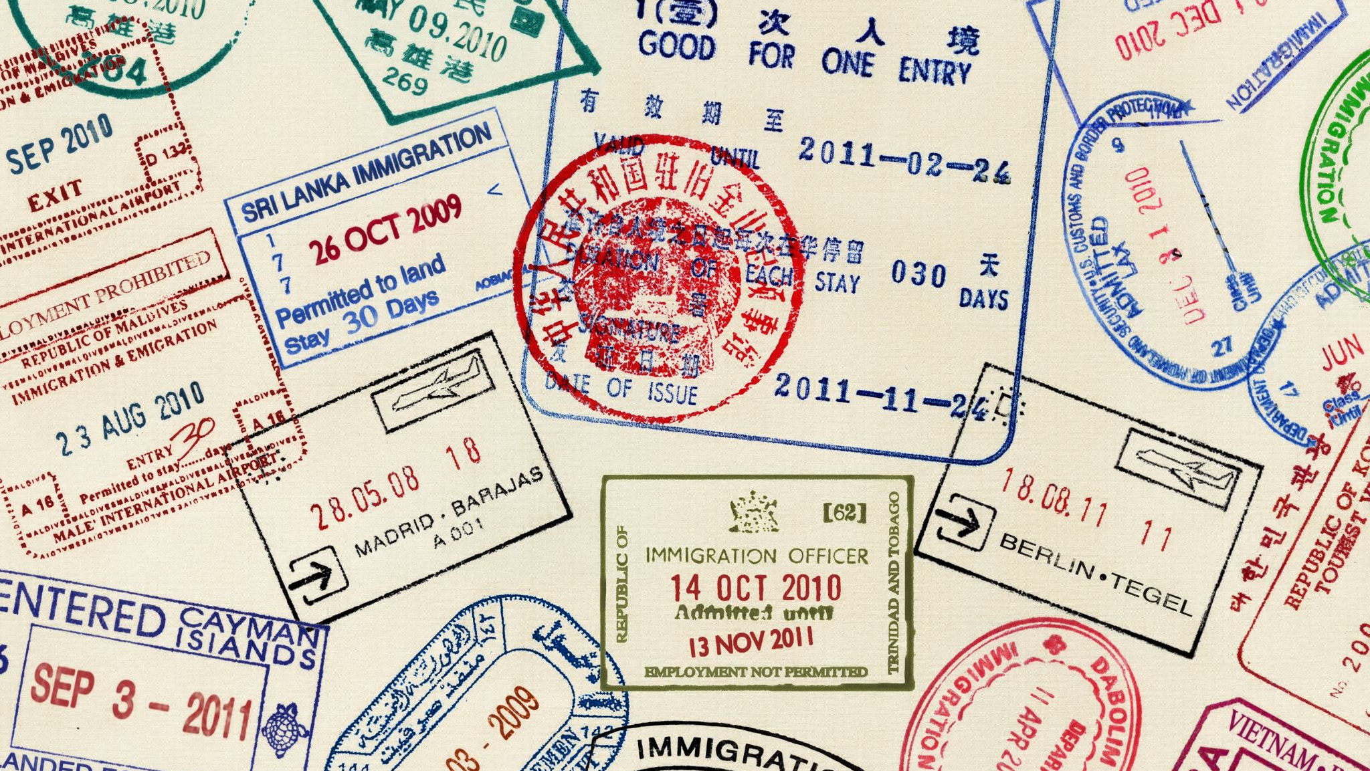
Supernaturally Stamped with Character
Christ-Like Character – Week 13

Slide 2

God doesn’t just want us to behave better; He wants to transform us from the inside out by stamping His character on our lives through the Holy Spirit.

Slide 3
Transformed by God’s Spirit
2 Corinthians 3:6, 17–18 teaches us that the Spirit gives life and transforms us into the image of Christ. This is not outward change alone, but inward transformation.
As believers, we are called to be both kings and priests who represent God’s nature to the world.
Andrew Murray reminds us that we don’t generate love by ourselves. Love flows from God into us and then through us to others.
Galatians 5:14: “The entire law is fulfilled in keeping this one command: Love your neighbor as yourself.” When God’s love rules in our hearts, we naturally live righteously, because true love cannot deliberately harm another person.

Slide 4
Why People Choose Man’s Way Instead of God’s Way
Low faith and high fear – When we don’t fully trust God, fear pushes us toward wrong choices.
Fear of unmet needs – People chase wealth, power, or success to feel secure, but God reminds us that our true worth is in Christ and His sacrifice for us.
Deception – Believing there are shortcuts in life. The enemy deceives people into thinking they can achieve lasting joy apart from God.
Greed – Preferring short-term gain over eternal reward. Many sacrifice long-term blessings for temporary satisfaction.
These four traps lead to poor choices and pull us away from God’s perfect will.

Slide 5
The Power of Choice
Deuteronomy 30:19: God has given us free will. We face choices daily, and He calls us to choose life by choosing His way.
When we choose God’s way, He gives us the strength to walk it out.

Slide 6
Building faith involves several steps:
Meditation on God’s Word
Illumination by the Holy Spirit, bringing revelation
Prayer of faith to align our hearts with His will
Confession of God’s truth over our lives
Possession – acting on God’s promises in daily living

Slide 7
Philippians 2:12–13 reminds us: we work out our salvation with fear and trembling, but it is God who works in us to will and to act.

Slide 8
Staying in the Flow of the Anointing
Even when we stumble, God calls us back. Romans 11:29 says His gifts and calling are irrevocable.
Proverbs 4:23: We must guard our hearts, because everything we do flows from it.
Paul warns in 1 Timothy 1:19 that some have “shipwrecked their faith” because they failed to hold onto faith and a good conscience.
Remaining in Christlike character keeps us connected to God’s Spirit, which releases His power through us.
2 Peter 1:5–8 outlines the qualities we are to develop: faith, goodness, knowledge, self-control, perseverance, godliness, mutual affection, and love. If these qualities are growing in us, our lives will be effective and fruitful for God’s kingdom.

Slide 9
Reflection & Challenge
God has stamped His Spirit on us so we can reflect His character.
Man’s way may seem easier or more appealing, but it always leads to emptiness. God’s way leads to freedom, security, and love.
The challenge: daily choose God’s way, depend on His Spirit, and allow His character to be formed in us.

