Slide 1
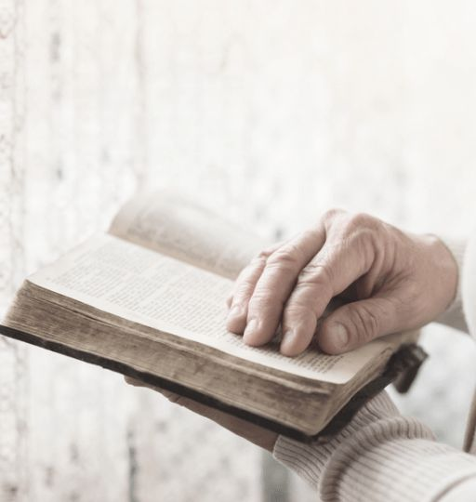
Grace Assembly of God Church
Bible Study
The Book of James
Practical Christian Living

Slide 2
The Book of James
PRACTICAL CHRISTIAN LIVING
WEEK 1
James Chapter 1 Living Out Faith
WEEK 2
James Chapter 2 Faith in Action
WEEK 3
James Chapter 3 Taming the Tongue
WEEK 4
James Chapter 4 Submitting to God
WEEK 5
James Chapter 5 Patience in Suffering

Slide 3
J
The Book of James Practical Christian Living
James Chapter 2
Life of Faith Everyday
Faith in Action
Grow & Mature
Relation with Jesus
No Prejudice

Slide 4
Questions that will be answered through today’s Bible Study
How can favouritism or prejudice affect a community of believers?
What is the "royal law," and how does favouritism break it?
Why does James say breaking one part of God's law is serious?
How do Abraham and Rahab show the link between faith and actions?

Slide 5
The following verses are from James 2 (New Living Translation)

Slide 6
Key Points
A Warning Against Favouritism
¹ My dear brothers and sisters, how can you claim to have faith in our glorious Lord Jesus Christ if you favor some people over others?
² For example, suppose someone comes into your meeting dressed in fancy clothes and expensive jewelry, and another comes in who is poor and dressed in dirty clothes. ³ If you give special attention and a good seat to the rich person, but you say to the poor one, “You can stand over there, or else sit on the floor”—well, ⁴ doesn’t this discrimination show that your judgments are guided by evil motives?

Slide 7
Key Points
God’s Choice and Human Discrimination
⁵ Listen to me, dear brothers and sisters. Hasn’t God chosen the poor in this world to be rich in faith? Aren’t they the ones who will inherit the Kingdom he promised to those who love him? ⁶ But you dishonor the poor! Isn’t it the rich who oppress you and drag you into court? ⁷ Aren’t they the ones who slander Jesus Christ, whose noble name you bear?

Slide 8
Key Points
The Royal Law
⁸ Yes indeed, it is good when you obey the royal law as found in the Scriptures: “Love your neighbor as yourself.” ⁹ But if you favor some people over others, you are committing a sin. You are guilty of breaking the law.

Slide 9
Key Points
Breaking One Law Equals Breaking All
¹⁰ For the person who keeps all of the laws except one is as guilty as a person who has broken all of God’s laws. ¹¹ For the same God who said, “You must not commit adultery,” also said, “You must not murder.” So if you murder someone but do not commit adultery, you have still broken the law.

Slide 10
Key Points
Mercy and Judgement
¹² So whatever you say or whatever you do, remember that you will be judged by the law that sets you free. ¹³ There will be no mercy for those who have not shown mercy to others. But if you have been merciful, God will be merciful when he judges you.

Slide 11
Key Points
Faith and Good Deeds
¹⁴ What good is it, dear brothers and sisters, if you say you have faith but don’t show it by your actions? Can that kind of faith save anyone? ¹⁵ Suppose you see a brother or sister who has no food or clothing, ¹⁶ and you say, “Good-bye and have a good day; stay warm and eat well”—but then you don’t give that person any food or clothing. What good does that do?
¹⁷ So you see, faith by itself isn’t enough. Unless it produces good deeds, it is dead and useless.

Slide 12
Key Points
Faith Demonstrated by Actions
¹⁸ Now someone may argue, “Some people have faith; others have good deeds.” But I say, “How can you show me your faith if you don’t have good deeds? I will show you my faith by my good deeds.”
¹⁹ You say you have faith, for you believe that there is one God. Good for you! Even the demons believe this, and they tremble in terror. ²⁰ How foolish! Can’t you see that faith without good deeds is useless?

Slide 13
Key Points
Abraham’s Faith and Actions
²¹ Don’t you remember that our ancestor Abraham was shown to be right with God by his actions when he offered his son Isaac on the altar? ²² You see, his faith and his actions worked together. His actions made his faith complete. ²³ And so it happened just as the Scriptures say: “Abraham believed God, and God counted him as righteous because of his faith.” He was even called the friend of God. ²⁴ So you see, we are shown to be right with God by what we do, not by faith alone.

Slide 14
Key Points
Rahab’s Example
²⁵ Rahab the prostitute is another example. She was shown to be right with God by her actions when she hid those messengers and sent them safely away by a different road. ²⁶ Just as the body is dead without breath, so also faith is dead without good works.

Slide 15
CONCLUSION
Live out your faith consistently
Align your beliefs and actions
Be a genuine disciple
Have a vibrant faith
Visibly demonstrate your faith
Produce good works
Live righteously

Slide 16
Task based on Chapter 2 (Pick any 1 task of your choice)
01
1. Identify a situation in your life where you may have shown favouritism or judged someone based on their appearance or status. Reflect on this experience and write down your thoughts. Plan to address this by asking God for wisdom and a more open heart to treat everyone equally and commit to consciously practicing this in your interactions.
REFLECT
02
2. Memorize James 2:17: "In the same way, faith by itself, if it is not accompanied by action, is dead." After memorizing it, reflect on what it means to have a faith that acts. Write down three specific actions you can take this week to demonstrate your faith through deeds and plan to follow through on those actions. (What, When & How)
MEMORIZE
03
3. Generate a list of inspiring quotes or one-liners based on the key teachings from James Chapter 2, focusing on themes like equality, faith in action, and compassion. Aim for at least five quotes.
CREATE

Slide 17
Proverbs 18:21 states that “The tongue has the power of life and death.”
~ Speaking positive affirmations rooted in Scripture helps us choose words that bring life, encouragement, and hope.

Slide 18
Personalized affirmations inspired by James Chapter 2
I will treat everyone with honour and respect, showing no favouritism!
My faith is powerful; I will demonstrate it through my actions every day!
I declare that I will love all people, regardless of their background or status!
I choose to act with compassion, making a difference in the lives of others!
I commit to serving others with a generous heart and a willing spirit!
My actions will reflect my faith; I will live out the love of Christ boldly!
I declare that my faith is alive and active, impacting my community for good!
I will be a beacon of hope and kindness, shining God’s light in the world!

Slide 19
Be Blessed!!

