Slide 1
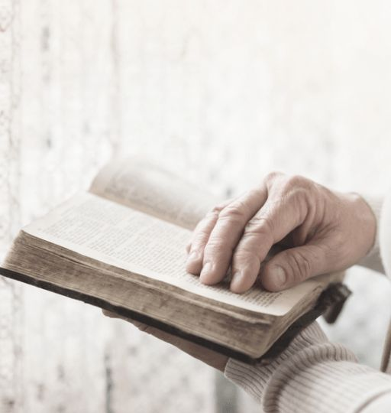
Grace Assembly of God Church
Bible Study
The Book of James
Practical Christian Living

Slide 2
Practical
Guide
Letter
The Book of James
PRACTICAL CHRISTIAN LIVING
WEEK 1
James Chapter 1 Living Out Faith
WEEK 2
James Chapter 2 Faith in Action
WEEK 3
James Chapter 3 Taming the Tongue
Life of Faith
Daily
WEEK 4
James Chapter 4 Submitting to God
WEEK 5
James Chapter 5 Patience in Suffering

Slide 3
J
The Book of James
Practical Christian Living
James Chapter 5
Misuse of Wealth
Patience & Endurance
Power of Prayer
Responsible to Restore
Reflect God’s Justice
Compassion & Righteousness

Slide 4
Questions that will be answered through today’s Bible Study
What warning does James give to the rich, and what are the specific consequences mentioned for their actions?
How does James illustrate the concept of patience and endurance, and what examples does he use to encourage believers?
What instructions does James give about how believers should respond to suffering and happiness?
How does James describe the effectiveness and power of prayer, and which biblical figure does he use to exemplify this?
What responsibility do believers have towards those who wander from the truth, and what are the outcomes of fulfilling this responsibility?

Slide 5
The following verses are from James 5 (New Living Translation)

Slide 6
Key Points
Warning to the Rich
¹ Look here, you rich people: Weep and groan with anguish because of all the terrible troubles ahead of you. ² Your wealth is rotting away, and your fine clothes are moth-eaten rags. ³ Your gold and silver are corroded. The very wealth you were counting on will eat away your flesh like fire. This corroded treasure you have hoarded will testify against you on the day of judgment. ⁴ For listen! Hear the cries of the field workers whom you have cheated of their pay. The cries of those who harvest your fields have reached the ears of the Lord of Heaven’s Armies.
⁵ You have spent your years on earth in luxury, satisfying your every desire. You have fattened yourselves for the day of slaughter. ⁶ You have condemned and killed innocent people, who do not resist you.

Slide 7
Key Points
Patience and Endurance
⁷ Dear brothers and sisters, be patient as you wait for the Lord’s return. Consider the farmers who patiently wait for the rains in the fall and in the spring. They eagerly look for the valuable harvest to ripen. ⁸ You, too, must be patient. Take courage, for the coming of the Lord is near.
⁹ Don’t grumble about each other, brothers and sisters, or you will be judged. For look—the Judge is standing at the door!
¹⁰ For examples of patience in suffering, dear brothers and sisters, look at the prophets who spoke in the name of the Lord. ¹¹ We give great honor to those who endure under suffering. For instance, you know about Job, a man of great endurance. You can see how the Lord was kind to him at the end, for the Lord is full of tenderness and mercy.
¹² But most of all, my brothers and sisters, never take an oath, by heaven or earth or anything else. Just say a simple yes or no, so that you will not sin and be condemned.

Slide 8
Key Points
The Power of Prayer
¹³ Are any of you suffering hardships? You should pray. Are any of you happy? You should sing praises. ¹⁴ Are any of you sick? You should call for the elders of the church to come and pray over you, anointing you with oil in the name of the Lord. ¹⁵ Such a prayer offered in faith will heal the sick, and the Lord will make you well. And if you have committed any sins, you will be forgiven.
¹⁶ Confess your sins to each other and pray for each other so that you may be healed. The earnest prayer of a righteous person has great power and produces wonderful results. ¹⁷ Elijah was as human as we are, and yet when he prayed earnestly that no rain would fall, none fell for three and a half years! ¹⁸ Then, when he prayed again, the sky sent down rain and the earth began to yield its crops.

Slide 9
Key Points
Restore Wandering Believers
¹⁹ My dear brothers and sisters, if someone among you wanders away from the truth and is brought back, ²⁰ you can be sure that whoever brings the sinner back from wandering will save that person from death and bring about the forgiveness of many sins.

Slide 10
Task based on Chapter 5
01
~ Reflect on how you manage your resources and treat others.
~ Spend a few minutes in prayer asking for insight.
~ Write down specific actions you will take to address any issues.
REFLECT
02
~ Memorize James 5:16: "The prayer of a righteous person is powerful and effective."
~ After memorizing, write down three ways you will use prayer in your life, including specific situations or people you will pray for.
MEMORIZE

Slide 11
Proverbs 18:21 states that “The tongue has the power of life and death.”
~ Speaking positive affirmations rooted in Scripture helps us choose words that bring life, encouragement, and hope.

Slide 12
Personalized affirmations inspired by James Chapter 5
I will trust in God’s timing and embrace patience in every circumstance.
I will pray with faith, knowing that my prayers are powerful and bring healing, comfort, and change.
I will use my resources justly and generously, reflecting God’s compassion and fairness.
I will remain steadfast in faith, knowing that the Lord is full of mercy and tenderness.
I will actively seek to restore those who have wandered from the truth, offering grace and guidance.
I will choose to speak honestly and simply, avoiding false oaths and embracing integrity.
I will celebrate both the good and the challenging moments of life, giving thanks and seeking God’s help.
I will be a source of encouragement and support for those around me, upholding them in prayer and action.

Slide 13
Be Blessed!!

